Slide 1
Friends of Dartmouth Community Orchard
Annual General Meeting Wednesday 1st May 2024 Dartmouth Yacht Club 5.00-6.15 pm approx.
Welcome, introductions & apologies
Agenda
Minutes of the Last AGM
Amendments to the Constitution
Committee Elections
Treasurer’s report for 2022 - 2023
Committee’s report
Objectives for 2024 and beyond
Any Other Business (previously notified)
Meeting Closure

Slide 2
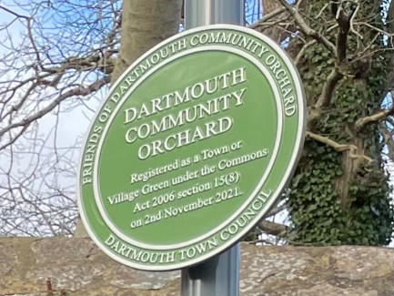
Amendments to the Constitution
Aim of the changes: - to introduce more flexibility for post holders - to take account of recent developments
Main changes: - inclusion of Village Green status - all appointments for two years - no restrictions on re-appointments - possibility of holding meetings remotely
Friends of Dartmouth Community Orchard

Slide 3
Elections
Secretary nomination – Julie Downing
Treasurer nomination – Pamela Nicholson
Peter Aylward & Lee Thorneywork
co-opted since last AGM: both now standing for election.
Current committee members continuing:
Jemma Pyne & Sally Walley Town Groundsman Matt Horan continues his co-option.
Peter Shaw & Alisa Kefford-Parker are not seeking re-election.
Friends of Dartmouth Community Orchard

Slide 4
Treasurer’s Report 2023
INCOME | 2023 | 2022 | 2021 | 2020
Donations and Subscriptions | £1,423.79 | £ 1,678.91 | £ 1,479.86 | £ 360.00
Seamoor Lottery | £355.50 | £ 483.00 | £ 510.50 | £ 698.50
Grants/Investments | £5,000.00 |  | £ 500.00
Total Income | £6,779.29 | £ 2,161.91 | £ 2,490.36 | £ 1,058.50
EXPENDITURE
Solar project | £1,846.53
Noticeboard/plaque/signs |  |  | £ 1,248.10
RHS Insurance | £90.00 | £ 90.00 | £ 90.00 | £ 90.00
Orchard Link subscription |  |  | £ 12.00 | £ 12.00
FODCO website |  | £ 100.00 |  | £ 132.75
Pathways | £95.40 | £ 140.65 | £ 1,153.93
Trees and consumables | £542.67 | £ 378.03 | £ 509.31 | £ 91.58
Beekeeping | £497.58 | £ 715.64 | £ 386.43
Biodiversity |  | £ 595.06 | £ 12.00
Gifts | £27.50 | £ 38.45
Adjustments | £114.99
Total expenditure | £3,214.67 | £ 2,057.83 | £ 3,411.77 | £ 326.33
c/f from previous year | £2,161.91 | £ 1,673.12 | £ 2,594.53 | £ 1,862.76
BALANCE | £5,201.82 | £ 2,161.91 | £ 1,673.12 | £ 2,594.53
Friends of Dartmouth Community Orchard

Slide 5
Committee’s 2023 Report
Site Management – Peter Shaw
Trees – Jemma Pyne
Bees – Janie Dodd (for Pamela Nicholson)
Biodiversity – Sally Walley
Events – Peter Shaw
Communications – Peter Shaw
Membership – Julie Downing
Summary – Peter Shaw
Friends of Dartmouth Community Orchard

Slide 6
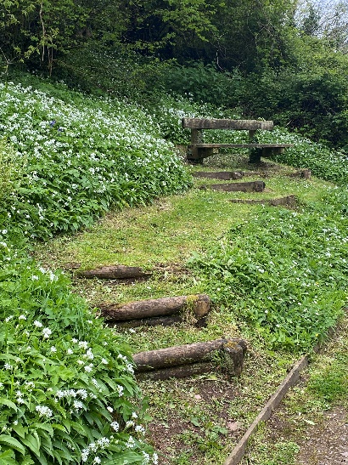
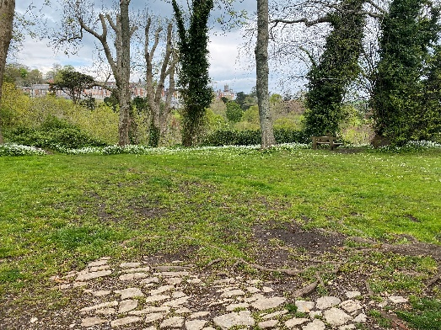
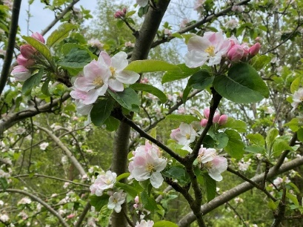
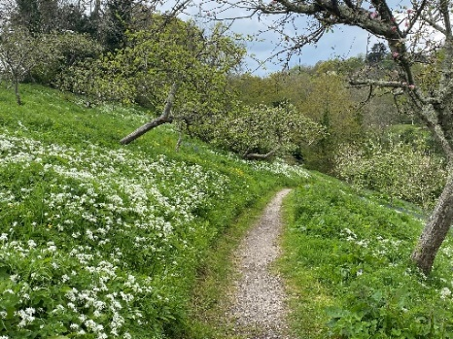
Site Management 1
Matt Horan and his team’s work
bi-weekly strimming Ridge Hill entrance area & path edges
complete strim of grassland annually
plus occasional jobs, e.g. tree planting, step making (hives & transect), etc.
Yellow Rattle trial seeding
ash die back – 1 tree felled; 1 oak sapling planted (donated by DTC)
Friends of Dartmouth Community Orchard

Slide 7
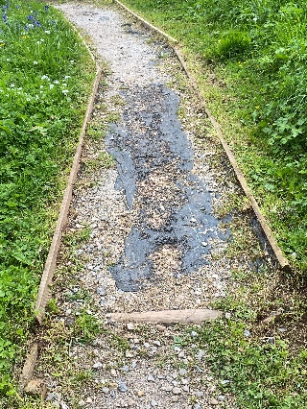
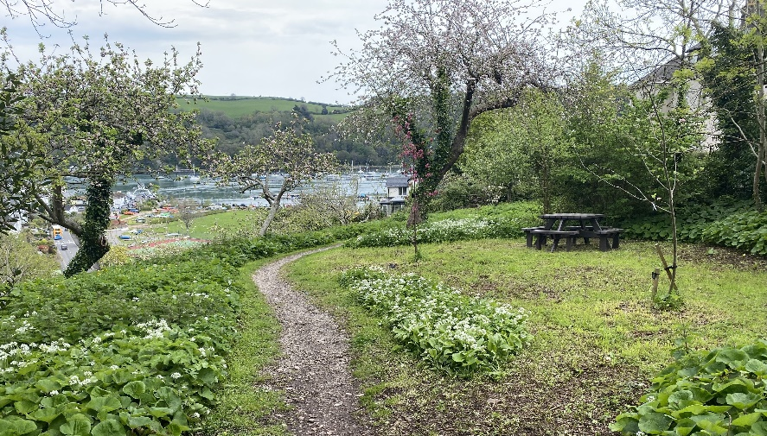
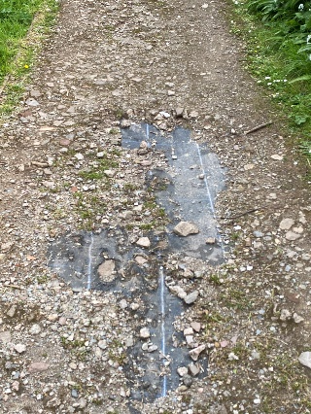
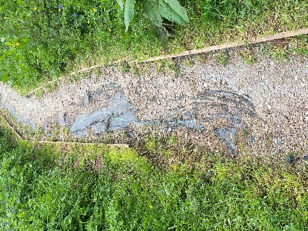
Site Management 2
Rhys Andrews (Properties Officer) project work
paths project progressing: scope, funding, quotations
gate repairs
new picnic bench
Council input increased
Friends of Dartmouth Community Orchard

Slide 8
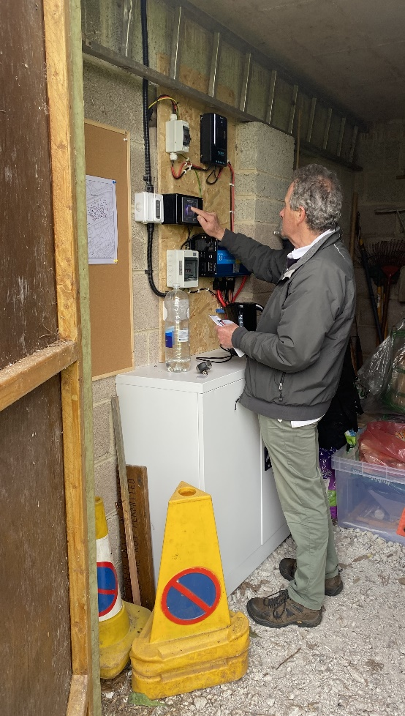
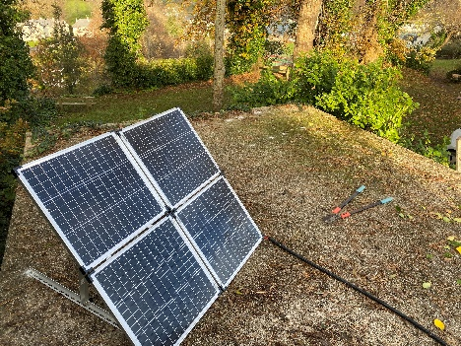
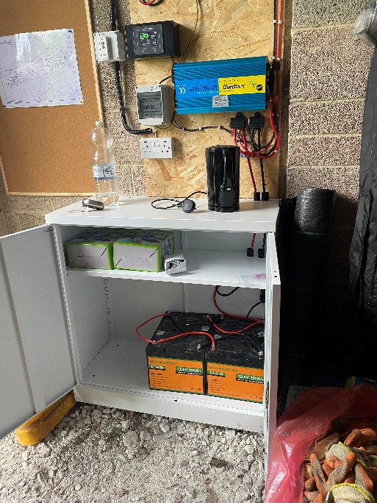
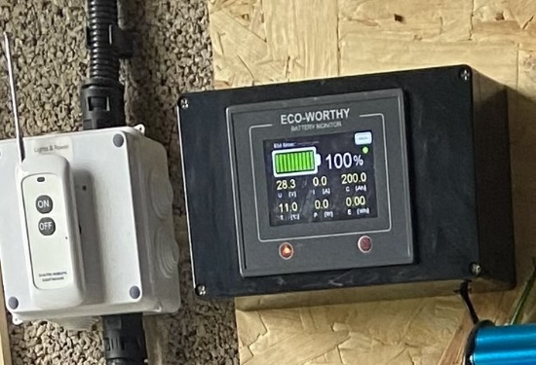
Site Management 3
Electricity Installation
- financed by DTC grant
solar panels & battery storage
lighting & power point
With great thanks to Pete Forey
Friends of Dartmouth Community Orchard

Slide 9
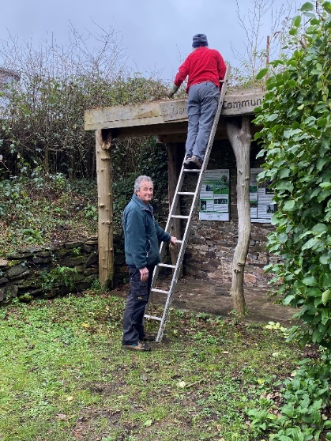
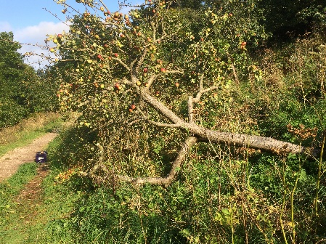
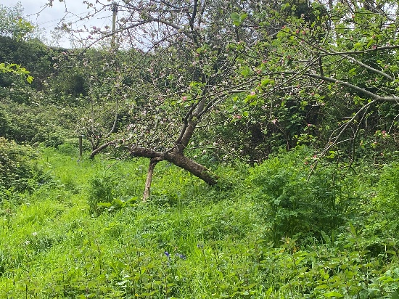
Site Management 4
Working Parties
tree management - epiphytic growth and dead boughs removed - scrub clearance around apple trees
- leaning trees propped
- young trees’ membrane & woodchip renewed - label adjustments
grisellinea, ivy & buddleia control round sub-station & shelter
clearance along ambulance station boundary
20 members participated in Working Parties
124 hours of effort
Friends of Dartmouth Community Orchard

Slide 10
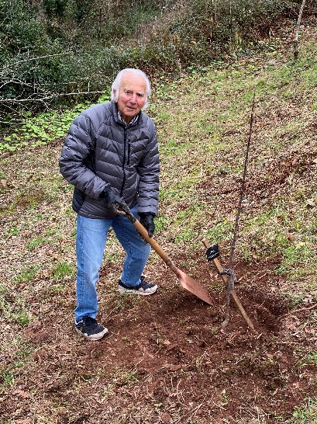
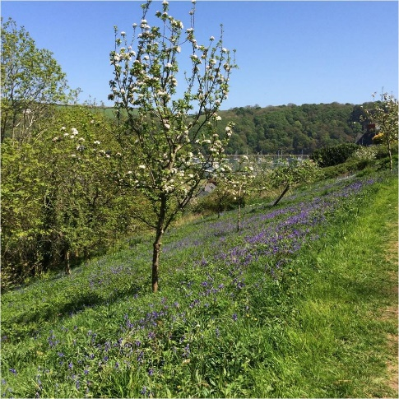
Apple Trees
2023: five new trees donated & planted including two old Devon varieties: - Devonshire Buckland - Devonshire Quarrenden
Systematic pruning programme continued with formative & restorative pruning
Two committee members attended Orchard Link pruning courses: newly acquired skills applied straight away!
Friends of Dartmouth Community Orchard

Slide 11
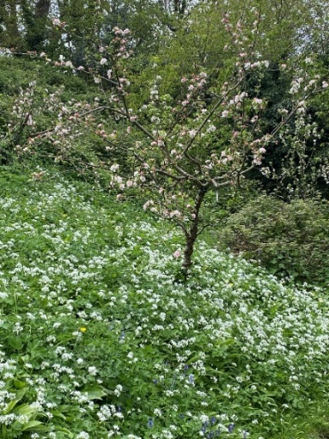
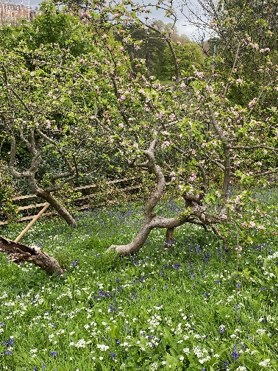
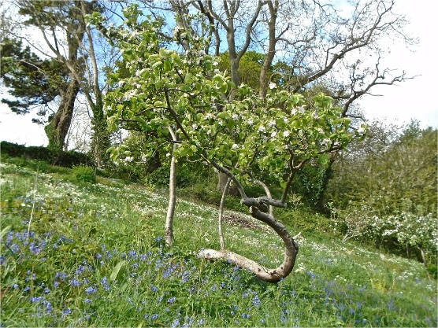
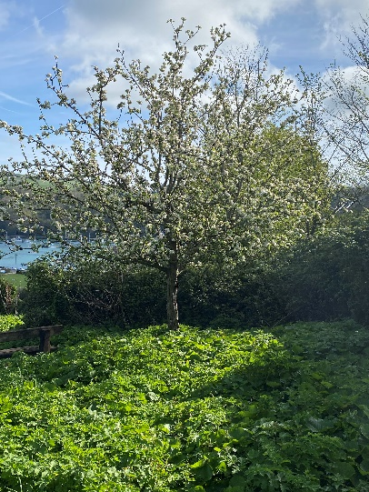
Tree Inventory
Tree database updated: - 149 apple trees
– at least 70 varieties
Tree mapping using GPS co-ordinates - partially complete
Memorial Tree Policy revised
Friends of Dartmouth Community Orchard

Slide 12
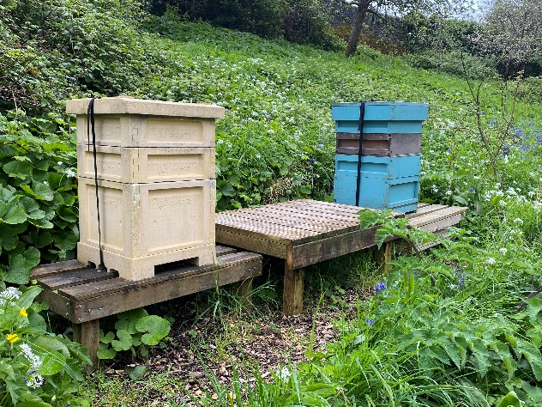
Bees
Bees
- colonies surviving a long winter; beginning to re-activate - supplementary feeding
Hives
- condition a concern: Polyhive no longer weather proof
- some frames with mould
- some honey has hardened
Honey
- 29 jars of honey last year
- larger harvest expected this year - need own honey spinner (loaned from South Hams Beekeepers in 2023)
Friends of Dartmouth Community Orchard

Slide 13
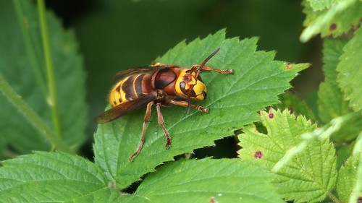
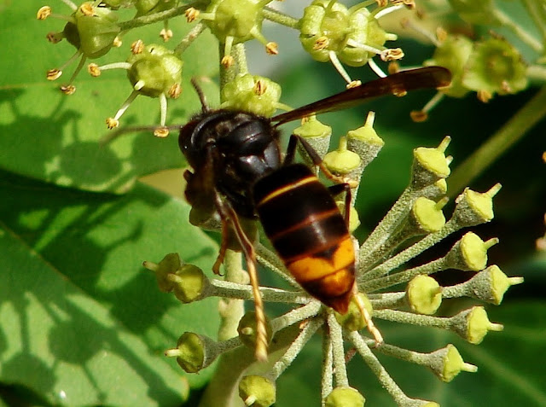
Bees to Biodiversity
Asian hornets
- increasing with changing climate - serious threat to bee colonies
This Photo by Unknown Author is licensed under CC BY-SA-NC
KEEP ALERT
&
REPORT IF SEEN
This Photo by Unknown Author is licensed under CC BY-NC-ND
Friends of Dartmouth Community Orchard

Slide 14
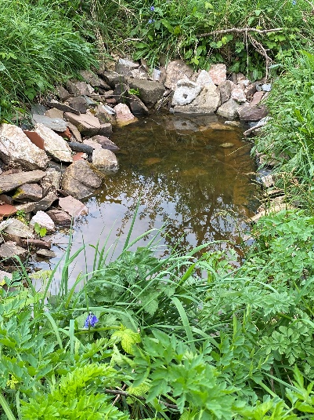
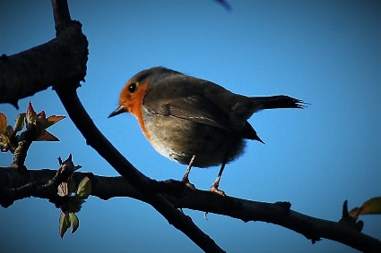
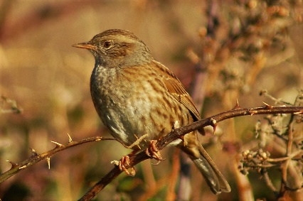
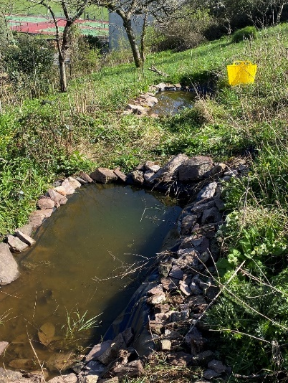
Biodiversity 1
Ponds - 1 in Western, 2 in Eastern paddock - lined with stone work - insects colonising
Birds
- Tawny Owl box not yet occupied - min 17 species foraging / breeding
- other species visit occasionally
Friends of Dartmouth Community Orchard

Slide 15
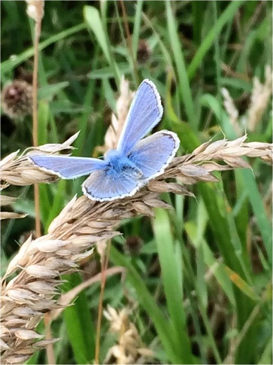
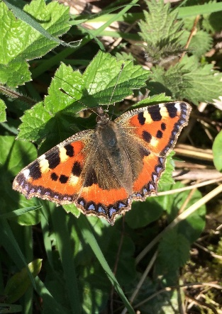
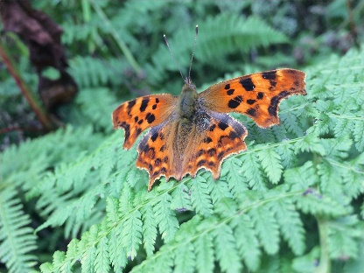
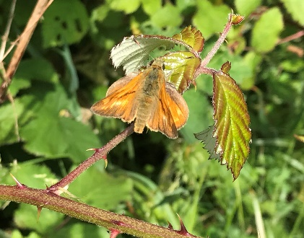
Biodiversity 2
Butterflies - transect instituted 2023
- weekly walk 1st April – 30th September
- follows same route, counting butterflies
- route takes in all the Orchard, College Way, & part of Coronation Park
- 17 species recorded plus 2 day-flying moths in 2023
- 5 species recorded in first 4 weeks of April 2024
Note:
four recorders share the task
(others would be welcome)
Friends of Dartmouth Community Orchard

Slide 16
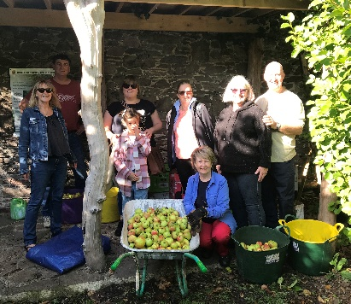
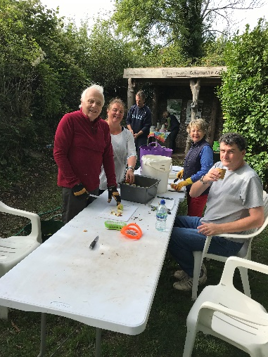
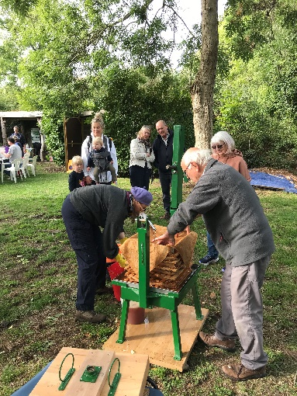
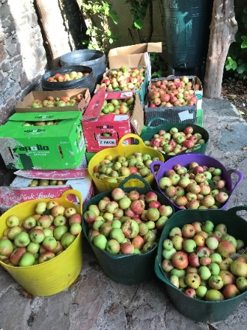
Events
May – informal gathering of Friends in the Orchard
Successful Apple Pressing in October
- despite tree stripping incident
Friends of Dartmouth Community Orchard

Slide 17
Communications
Regular newsletters by email to members
Jon Hall, Friend, regular Orchard user & media professional, volunteered to manage our website and social media
Web site updated
www.dartmouthcommunityorchard.co.uk
Facebook & Instagram being re-energised
Dartmouth Community Orchard
Friends of Dartmouth Community Orchard

Slide 18
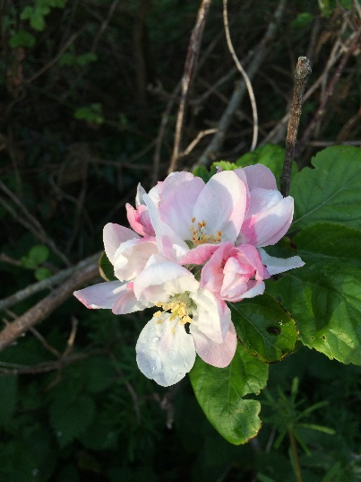
Membership
201 members as of April 2024
5 new members since the last AGM
Small numbers lost - some long term Friends have died
- others moved away (wish us well when notifying us!)
Friends of Dartmouth Community Orchard

Slide 19
2023 Priorities - Summary
Site Management
- Monitoring the progress of Ash dieback - Installing a water and electricity supply in the sub-station - Improving the state of the grassland - Maintaining the programme of tree care and renewal - Path maintenance
Biodiversity
- Ensuring the Bee Hives flourish - honey collection
- Ensuring the ponds are established
- Monitoring the new owl box & reptile refugia
- Establishing a butterfly transect
Good result overall.
Friends of Dartmouth Community Orchard

Slide 20
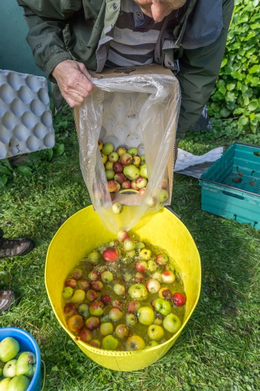
2024 Priorities – Summary
Monitor impact of Yellow Rattle on grass sward.
Renew all-weather path surface - Western Paddock.
Maintain rolling programme of pruning and tree care.
Continue to accept new trees according to policy
Acquire honey spinner - obtain grant if possible
Repeat our two principal events – May Day & Apple Pressing.
Friends of Dartmouth Community Orchard

Slide 21
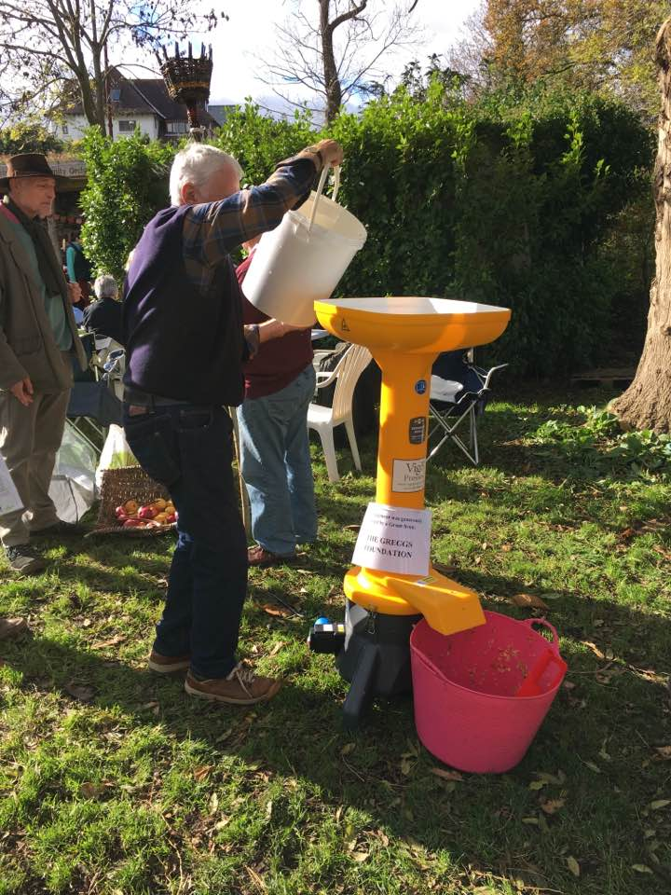
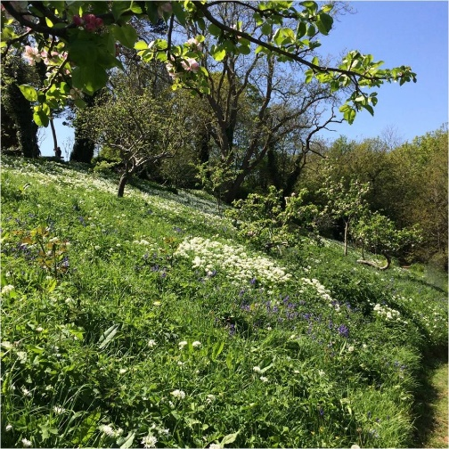
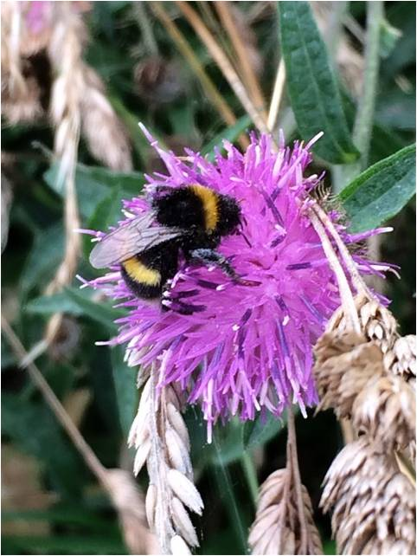
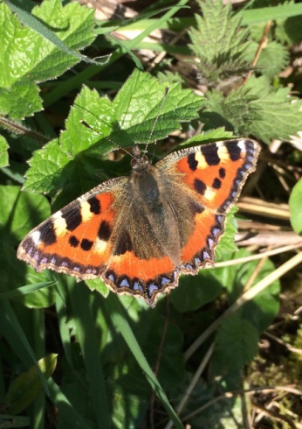
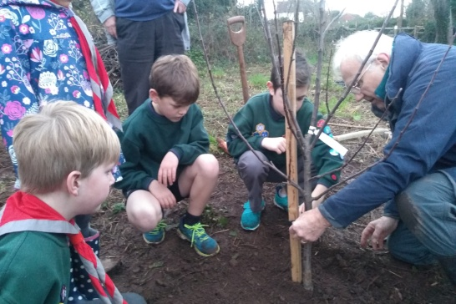
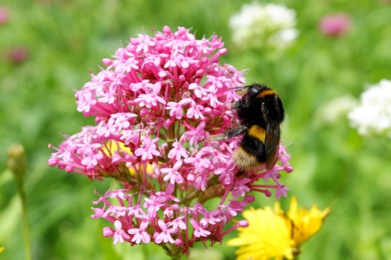
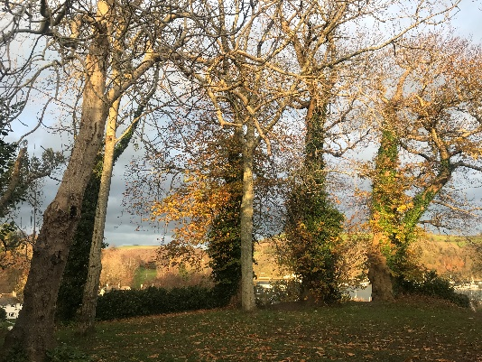
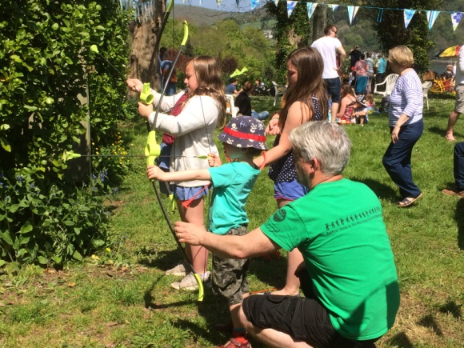
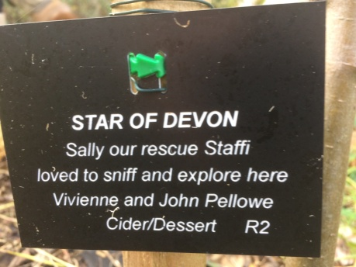
Questions
Ideas
Friends of Dartmouth Community Orchard

